Slide 1
RTC EEPROM Interfacing
DS1307 (RTC) + 24CXX (EEPROM)

Slide 2

What is Real Time Clock?
Real Time Clock or RTC is a system that keeps track of the current time and can be used in any device which needs to keep accurate time.
RTCs have some important advantages.
Low power consumption
Releasing system time from time calculation (this feature is critical because in many cases CPU is operating some delicate tasks like receiving sensors data. and if you don’t use RTC, CPU also has to keep track of the time and it can disrupt processors main tasks.)
High accuracy
RTCs often have an alternate source of power, so that they can continue to keep time while the primary source of power is off or unavailable.
RTCs often use a 32.768 kHz crystal oscillator. But why 32,768?
32768 is equal to 215 and hence can generate 1 second easily.
Also, the crystal must be small with proper width and low power consumption, which can be satisfied with using 32876 Hz. Higher frequencies are larger and fragile crystals, and the lower frequencies have more power consumption that 32, 768KHz.

Slide 3
DS1307 Module Feature & Specifications
DS1307 module is one of the most affordable and common RTCs modules. It can accurately keep track of seconds, minutes, hours, days, months, and years.
Some of the DS1307 important features are:
Ability of Generating Programmable Square-Wave
Low Current Use; under 500nA in Battery Backup mode
The Ability to Set the Date Up to Year 2100
I2C Serial Interface
The DS1307 module has the capability to install a 3-volt CR2023 backup battery. there is also an embedded EEPROM 24c32 memory on this module that can save 32kb of data.

Slide 4
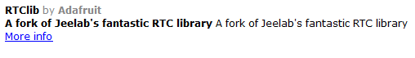
Hardware Required
Arduino board (Uno, Mega)
Jumper cables (as per breakout headers)
DS1307 (RTC) + 24Cxx (EEPROM)
USB connection cable
SOFTWARE Required
RTC_DS1307 – You need the RTClib library to use DS1307 with Arduino

Slide 5
PINOUT
PIN on DS1307 board | Operation | Pin on Arduino
Vcc | +5V | 5V
GND | GND | GND
SDA | RTC & EEPROM I2C Data Line | A4 (Analog Input Pin 4)
SCL | RTC & EEPROM I2C Clock Line | A5 (Analog Input Pin 5)

Slide 6
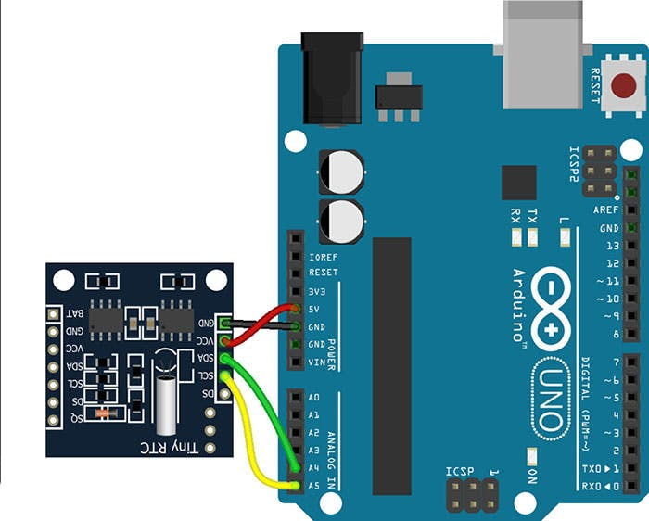
Circuit
RTC part communicates with the microcontroller using I2C protocol.
PIN on DS1307 board | Pin on Arduino
Vcc | 5V
GND | GND
SDA | A4 (Analog Input Pin 4)
SCL | A5 (Analog Input Pin 5)

Slide 7
Code-1 RTC EEPROM Interfacing

Slide 8
Code RTC EEPROM Interfacing
// Date and time functions using a DS1307 RTC connected via I2C and Wire lib
#include <Wire.h>
#include "RTClib.h"
#define SERIAL_BAUDRATE 115200
/* Create an RTC clock instance */
RTC_DS1307 rtc;
char daysOfTheWeek[7][12] = {"Sunday", "Monday", "Tuesday", "Wednesday", "Thursday", "Friday", "Saturday"};
void setup () {
while (!Serial); // for Leonardo/Micro/Zero
Serial.begin( SERIAL_BAUDRATE );
if (! rtc.begin()) {
Serial.println("Couldn't find RTC");
while (1);
}
if (! rtc.isrunning()) {
Serial.println("RTC is NOT running!");
// following line sets the RTC to the date & time this sketch was compiled
rtc.adjust(DateTime(F(__DATE__), F(__TIME__)));
// This line sets the RTC with an explicit date & time, for example to set
// January 21, 2014 at 3am you would call:
// rtc.adjust(DateTime(2014, 1, 21, 3, 0, 0));
}
}

Slide 9
Code RTC EEPROM Interfacing
void loop () {
/* Get current time (read from EEPROM) */
DateTime now = rtc.now();
Serial.print(now.year(), DEC);
Serial.print('/');
Serial.print(now.month(), DEC);
Serial.print('/');
Serial.print(now.day(), DEC);
Serial.print(" (");
Serial.print(daysOfTheWeek[now.dayOfTheWeek()]);
Serial.print(") ");
Serial.print(now.hour(), DEC);
Serial.print(':');
Serial.print(now.minute(), DEC);
Serial.print(':');
Serial.print(now.second(), DEC);
Serial.println();
Serial.print(" since midnight 1/1/1970 = ");
Serial.print(now.unixtime());
Serial.print("s = ");
Serial.print(now.unixtime() / 86400L);
Serial.println("d");
// calculate a date which is 7 days and 30 seconds into the future
DateTime future (now + TimeSpan(7, 12, 30, 6));
Serial.print(" now + 7d + 30s: ");
Serial.print(future.year(), DEC);
Serial.print('/');
Serial.print(future.month(), DEC);
Serial.print('/');
Serial.print(future.day(), DEC);
Serial.print(' ');
Serial.print(future.hour(), DEC);
Serial.print(':');
Serial.print(future.minute(), DEC);
Serial.print(':');
Serial.print(future.second(), DEC);
Serial.println();
Serial.println();
delay(3000);
}

Slide 10

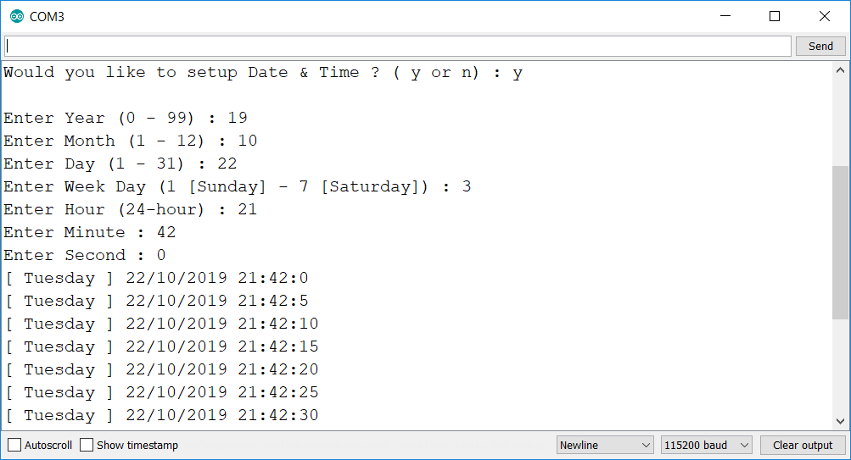

CODE-2 Get SET Time Using serial port

Slide 11
Code Get SET Time Using serial port
#include <Wire.h>
#define SERIAL_BAUDRATE 115200
/* RTC Module I2C address */
#define DS1307_ADDRESS 0x68
byte zero = 0x00;
/* Structure of RTC */
typedef struct DateTime_
{
uint8_t year;
uint8_t month;
uint8_t day;
uint8_t weekday;
uint8_t hour;
uint8_t minute;
uint8_t second;
}DateTime_t;
DateTime_t xDateTime;
byte decToBcd(byte val){
#if 1
// Convert normal decimal numbers to binary coded decimal
// We need to do this, else time is treated as decimal, and seconds and minutes go till 100 :(
return ( (val/10*16) + (val%10) );
#else
return val;
#endif
}
byte bcdToDec(byte val) {
#if 1
// Convert binary coded decimal to normal decimal numbers
// We need to do this, else time is treated as decimal, and seconds and minutes go till 100 :(
return ( (val/16*10) + (val%16) );
#else
return val;
#endif
}

Slide 12
Code Get SET Time Using serial port
char * pcGetWeekDayStr( uint8_t uiWeekDay )
{
char * pcWeekDay = (char *) "INVALID";
switch( uiWeekDay )
{
case 1:
pcWeekDay = (char *) "Sunday";
break;
case 2:
pcWeekDay = (char *) "Monday";
break;
case 3:
pcWeekDay = (char *) "Tuesday";
break;
case 4:
pcWeekDay = (char *) "Wednessday";
break;
case 5:
pcWeekDay = (char *) "Thursday";
break;
case 6:
pcWeekDay = (char *) "Friday";
break;
case 7:
pcWeekDay = (char *) "Saturday";
break;
}
return pcWeekDay;
}

Slide 13
Code Get SET Time Using serial port
void vGetRtcFromUser()
{
/* Get Year */
Serial.print("Enter Year (0 - 99) : ");
while( Serial.available() == 0 ); // Wait for user input
xDateTime.year = strtoul(Serial.readString().c_str(), NULL, 0);
Serial.println(xDateTime.year);
/* Get Month */
Serial.print("Enter Month (1 - 12) : ");
while( Serial.available() == 0 ); // Wait for user input
xDateTime.month = strtoul(Serial.readString().c_str(), NULL, 0);
Serial.println(xDateTime.month);
/* Get Day */
Serial.print("Enter Day (1 - 31) : ");
while( Serial.available() == 0 ); // Wait for user input
xDateTime.day = strtoul(Serial.readString().c_str(), NULL, 0);
Serial.println(xDateTime.day);
/* Get Week Day */
Serial.print("Enter Week Day (1 [Sunday] - 7 [Saturday]) : ");
while( Serial.available() == 0 ); // Wait for user input
xDateTime.weekday = strtoul(Serial.readString().c_str(), NULL, 0);
Serial.println(xDateTime.weekday);
/* Get Hour */
Serial.print("Enter Hour (24-hour) : ");
while( Serial.available() == 0 ); // Wait for user input
xDateTime.hour = strtoul(Serial.readString().c_str(), NULL, 0);
Serial.println(xDateTime.hour);
/* Get Minute */
Serial.print("Enter Minute : ");
while( Serial.available() == 0 ); // Wait for user input
xDateTime.minute = strtoul(Serial.readString().c_str(), NULL, 0);
Serial.println(xDateTime.minute);
/* Get Second */
Serial.print("Enter Second : ");
while( Serial.available() == 0 ); // Wait for user input
xDateTime.second = strtoul(Serial.readString().c_str(), NULL, 0);
Serial.println(xDateTime.second);
}

Slide 14
Code Get SET Time Using serial port
void setDateTime()
{
vGetRtcFromUser();
byte second = xDateTime.second; //0-59
byte minute = xDateTime.minute; //0-59
byte hour = xDateTime.hour; //0-23
byte weekDay = xDateTime.weekday; //1-7
byte monthDay = xDateTime.day; //1-31
byte month = xDateTime.month; //1-12
byte year = xDateTime.year; //0-99
Wire.beginTransmission(DS1307_ADDRESS);
Wire.write(zero); //stop Oscillator
Wire.write(decToBcd(second));
Wire.write(decToBcd(minute));
Wire.write(decToBcd(hour));
Wire.write(decToBcd(weekDay));
Wire.write(decToBcd(monthDay));
Wire.write(decToBcd(month));
Wire.write(decToBcd(year));
Wire.write(zero); //start
Wire.endTransmission();
}
void printDate()
{
// Reset the register pointer
Wire.beginTransmission(DS1307_ADDRESS);
Wire.write(zero);
Wire.endTransmission();
Wire.requestFrom(DS1307_ADDRESS, 7);
int second = bcdToDec(Wire.read());
int minute = bcdToDec(Wire.read());
int hour = bcdToDec(Wire.read() & 0b111111); //24 hour time
int weekDay = bcdToDec(Wire.read()); //0-6 -> Sunday - Saturday
int monthDay = bcdToDec(Wire.read());
int month = bcdToDec(Wire.read());
int year = bcdToDec(Wire.read());
//print the date e.g [Tuesday] 22/10/2019 23:59:59
Serial.print("[ ");
Serial.print(pcGetWeekDayStr(weekDay));
Serial.print(" ] ");
Serial.print(monthDay);
Serial.print("/");
Serial.print(month);
Serial.print("/");
Serial.print(2000 + year);
Serial.print(" ");
Serial.print(hour);
Serial.print(":");
Serial.print(minute);
Serial.print(":");
Serial.println(second);
}

Slide 15
Code Get SET Time Using serial port
void setup ()
{
String cliOption = "";
Wire.begin();
Serial.begin( SERIAL_BAUDRATE );
Serial.print("Would you like to setup Date & Time ? ( y or n) : ");
while( Serial.available() == 0 ); // Wait for user input
cliOption = Serial.readString(); // cliOption = "y + NULL" or "n + NULL"
Serial.println(cliOption);
if( strncmp( cliOption.c_str(),"y", 1) == 0 ) // Compare only first ASCII char
{
setDateTime(); //MUST CONFIGURE IN FUNCTION
}
}
void loop ()
{
/* Get current time (read from EEPROM) */
printDate();
delay(5000);
}

Slide 16
EEPROM Interfacing ( Internal )

Slide 17
EEPROM INTERNAL - WRITE
The microcontroller on the Arduino and Genuino boards have 256 / 512 bytes of EEPROM: memory whose values are kept when the board is turned off (like a tiny hard drive).
This example illustrates how to store values (basically we write ADDRESS at ADDRESS into the EEPROM using the EEPROM.write() function.
These values will stay in the EEPROM when the board is turned off and may be retrieved later by another sketch.

Slide 18
INTERNAL EEPROM R/w - CODE
/*
* EEPROM (Internal) Read / Write Code
*
* The Code Reads (and dumps on serial port) Initial values
* of EEPROM (Internal), then Writes Values 0x00xx to Address (0xabxx)
*
* PS : Only the LSByte of Address is written to address of EEPROM.
* Remember each Address is 8bit / 1 byte long....right ;)
*
* Author : Sudhanshu Gupta
* Email : cool.sudhanshu@gmail.com
* Date : 26 Oct 2016
*/
#include <EEPROM.h>
#define SERIAL_BAUDRATE 115200
#define READ_ENABLE 1 /* Enable to Read from Internal EEPROM */
#define WRITE_ENABLE 1 /* Enable to Write to Internal EEPROM */

Slide 19
INTERNAL EEPROM R/w - CODE
#if READ_ENABLE
void ReadInternalEEPROM()
{
// start reading from the first byte (address 0) of the EEPROM
int address = 0;
byte value = 0;
Serial.println("Reading from internal EEPROM : ");
while(1)
{
// read a byte from the current address of the EEPROM
value = EEPROM.read(address);
Serial.print("Read Value (0x");
Serial.print(value, HEX);
Serial.print(") from Address (0x");
Serial.print(address, HEX);
Serial.println(")");
address = address + 1;
if (address == EEPROM.length()) {
address = 0;
break;
}
/***
As the EEPROM sizes are powers of two, wrapping (preventing overflow) of an
EEPROM address is also doable by a bitwise and of the length - 1.
++address &= EEPROM.length() - 1;
***/
}
}
#endif
#if WRITE_ENABLE
void WriteInternalEEPROM()
{
// start reading from the first byte (address 0) of the EEPROM
int address = 0;
byte value = 0;
Serial.println("Writing to Internal EEPROM : ");
while(1)
{
Serial.print("Writing Value (0x");
Serial.print(value, HEX);
Serial.print(") at Address (0x");
Serial.print(address, HEX);
Serial.println(")");
EEPROM.write(address, value);
value = address = address + 1;
if (address == EEPROM.length()) {
value = address = 0;
break;
}
}
}
#endif

Slide 20
INTERNAL EEPROM R/w - CODE
void setup()
{
/* Initialize Serial bus */
Serial.begin( SERIAL_BAUDRATE );
/* Print EEPROM Size (in bytes) */
Serial.print("Internal EEPROM size = ");
Serial.print(EEPROM.length());
Serial.println(" bytes.");
/* Read Initial EEPROM Contents */
#if READ_ENABLE
ReadInternalEEPROM();
#endif
/* Write New EEPROM Contents */
#if WRITE_ENABLE
WriteInternalEEPROM();
#endif
/* Read New EEPROM Contents */
#if READ_ENABLE
ReadInternalEEPROM();
#endif
}
void loop ()
{
delay(1000);
}

Slide 21
EEPROM Interfacing ( EXTERNAL )

Slide 22
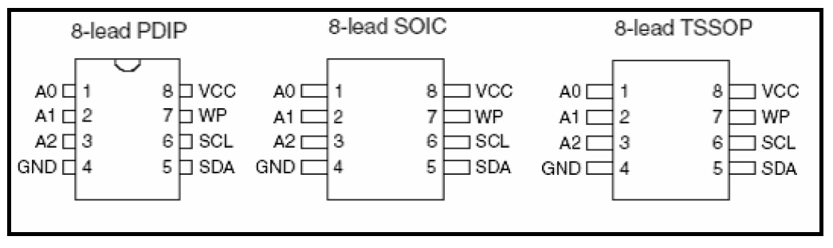
EEPROM Interfacing 24C02 / 24C04
24C02 / 24C04 provides 2048 / 4096 bits of serial electrically erasable and programmable read-only memory (EEPROM) organized as 256 / 512 words of 8 bits each.
The 24C02 / 24C04 is available in space-saving
8-lead PDIP ( Plastic Dual Inline Package ),
8-lead JEDEC (Joint Electron Device Engineering Council) SOIC,
8-lead TSOP (Thin Small Outline Package).
The EEPROM is accessible via a Two-wire serial interface.

Slide 23
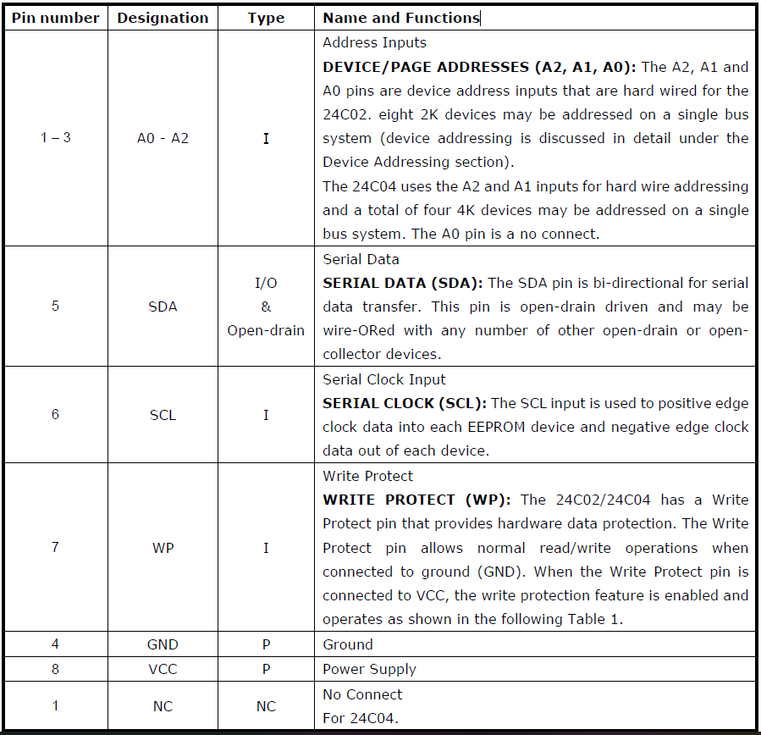
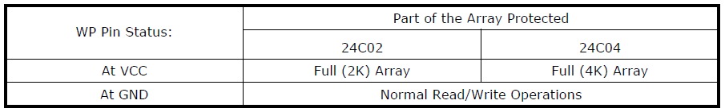
PINOUT Details

Slide 24
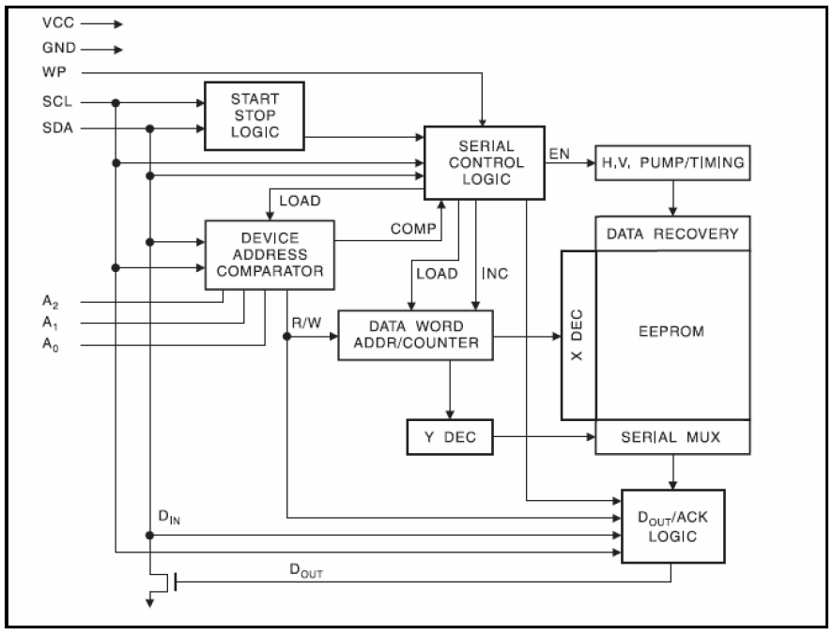
BLOCK DIAGRAM

Slide 25
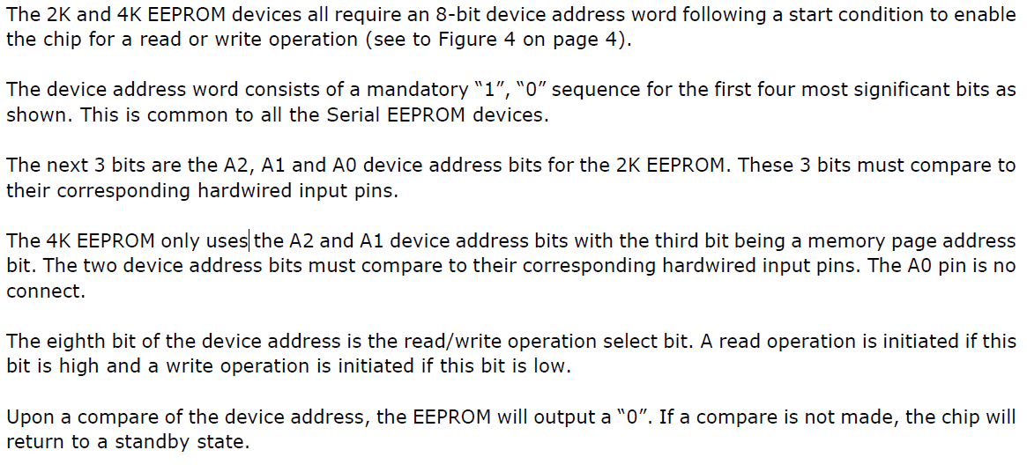
Device addressing

Slide 26
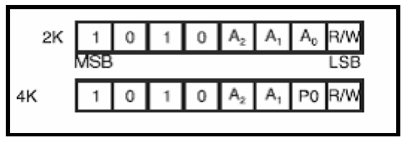
Device addressing

Slide 27
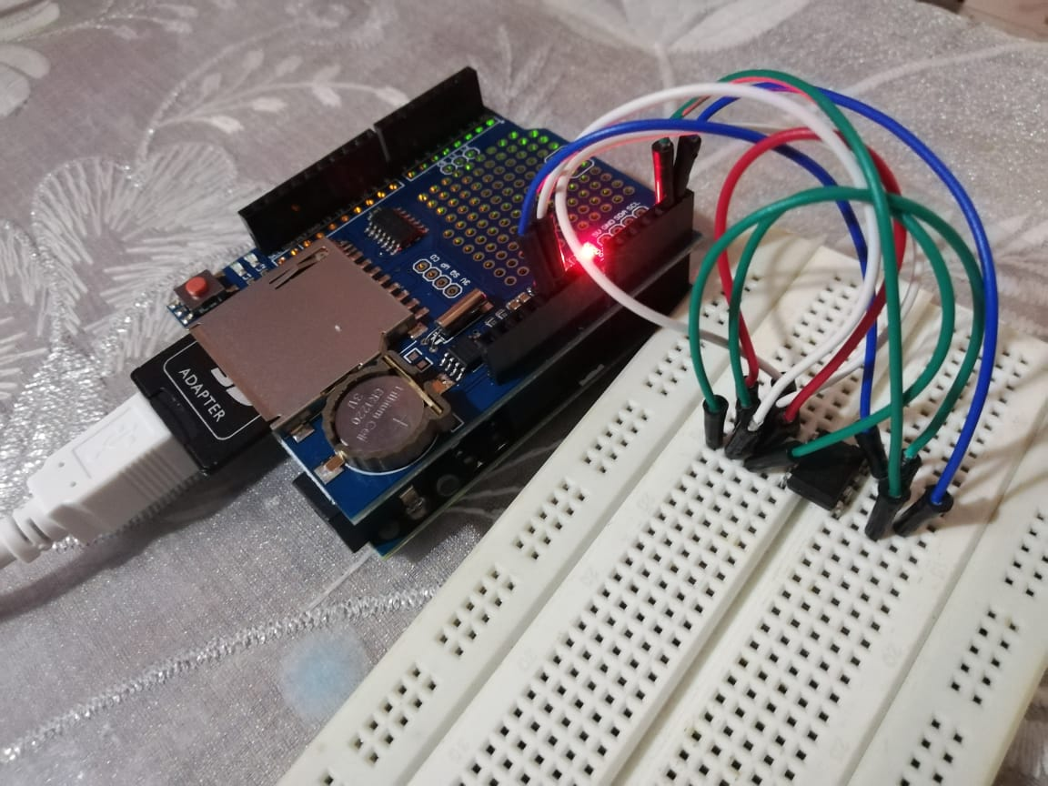
Actual PICS

Slide 28
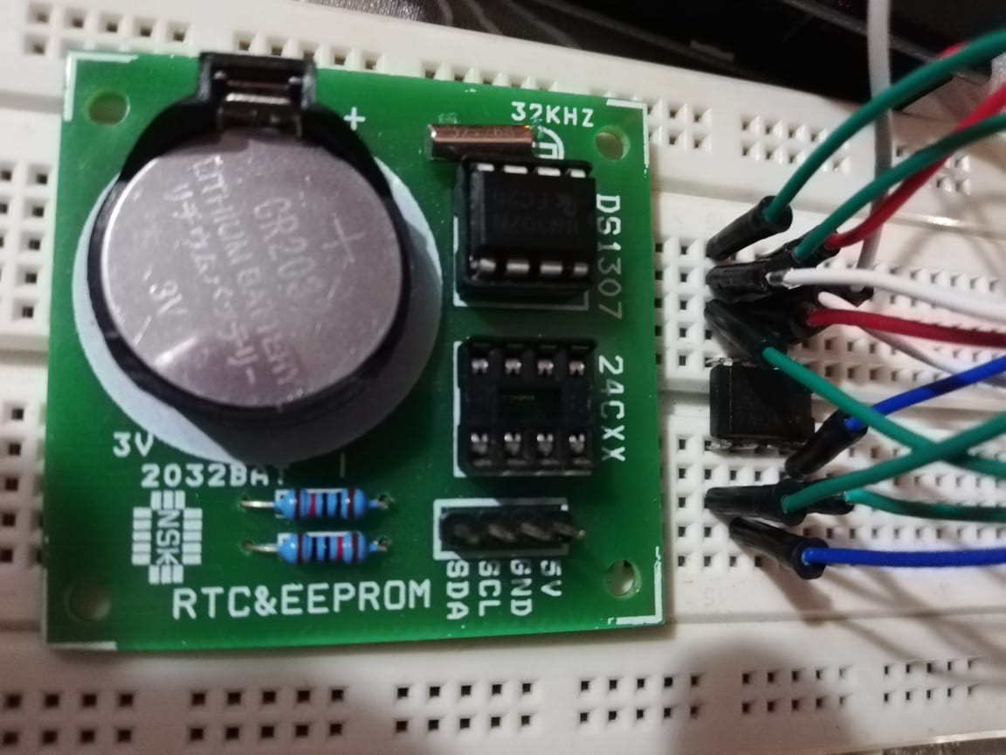
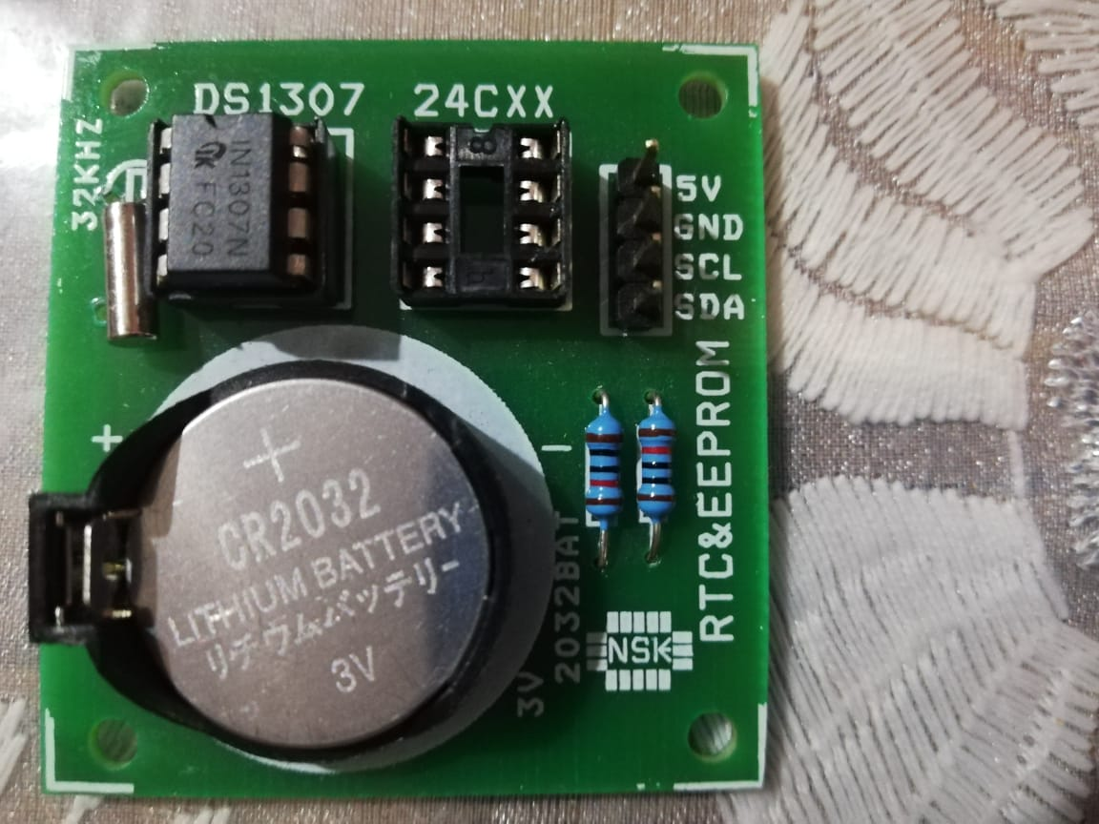

Slide 29
External EEPROM R/w - CODE

Slide 30
Sketch file

